Slide 1
THE MINOR PROPHETS
The Book of Nahum
Nah. 2:1-13

Slide 2
Nah. 2:1 He that dasheth in pieces is come up before thy face: keep the munition, watch the way, make thy loins strong, fortify thy power mightily.
2 For the LORD hath turned away the excellency of Jacob, as the excellency of Israel: for the emptiers have emptied them out, and marred their vine branches.
3 The shield of his mighty men is made red, the valiant men are in scarlet: the chariots shall be with flaming torches in the day of his preparation, and the fir trees shall be terribly shaken.
4 The chariots shall rage in the streets, they shall justle one against another in the broad ways: they shall seem like torches, they shall run like the lightnings.
5 He shall recount his worthies: they shall stumble in their walk; they shall make haste to the wall thereof, and the defence shall be prepared.
6 The gates of the rivers shall be opened, and the palace shall be dissolved.

Slide 3
7 And Huzzab shall be led away captive, she shall be brought up, and her maids shall lead her as with the voice of doves, tabering upon their breasts.
8 But Nineveh is of old like a pool of water: yet they shall flee away. Stand, stand, shall they cry; but none shall look back.

Slide 4
Rom. 15:4 For whatsoever things were written aforetime were written for our learning, that we through patience and comfort of the scriptures might have hope.
Rom. 11:22 Behold therefore the goodness and severity of God: on them which fell, severity; but toward thee, goodness, if thou continue in his goodness: otherwise thou also shalt be cut off.
I. NINEVEH’S DOOM DECLARED, 1:1-15
A. The Lord’s Patience, 1:1-3a, Gen. 10:8-12, Deut. 32:35, 41, Rom. 12:19, Psa. 7:11, Jn. 3:36
B. The Lord’s Power, 1:3b-5, Job 38:1, 40:6, Nah. 1:5, Ex. 19:18, Jud. 5:5, 2 Pet. 3:10, Rev. 6:16
C. The Lord’s Presence, 1:6-8, Rom. 11:22, Psa. 27:1, 27:5, 37:39, 41:1, Isa. 33:2, Jer. 14:8, Dan. 12:1, Jer. 30:7
D. The Lord’s Purpose, 1:9-14, Prov. 6:18, 12:20, 2 Kgs. 18:19, 26-31, 19:20-22, 19:35-37, Isa. 37:36-38
E. The Lord’s Protection, 1:15, Isa. 52:7, Rom. 10:15

Slide 5
II. NINEVEH’S DOOM DESCRIBED, 2:1-13
A. The Siege of Nineveh, 2:1-8
Nah. 2:1 He that dasheth in pieces is come up before thy face: keep the munition, watch the way, make thy loins strong, fortify thy power mightily.
Hos. 10:14 Therefore shall a tumult arise among thy people, and all thy fortresses shall be spoiled, as Shalman spoiled Betharbel in the day of battle: the mother was dashed in pieces upon her children.

Slide 6
Hos. 13:16 Samaria shall become desolate; for she hath rebelled against her God: they shall fall by the sword: their infants shall be dashed in pieces, and their women with child shall be ripped up.
Nah. 3:10 Yet was she carried away, she went into captivity: her young children also were dashed in pieces at the top of all the streets: and they cast lots for her honourable men, and all her great men were bound in chains.
Ezek. 23:24 And they shall come against thee with chariots, wagons, and wheels, and with an assembly of people, which shall set against thee buckler and shield and helmet round about: and I will set judgment before them, and they shall judge thee according to their judgments.

Slide 7
Nah. 2:2 For the LORD hath turned away the excellency of Jacob, as the excellency of Israel: for the emptiers have emptied them out, and marred their vine branches.
Nah. 2:3 The shield of his mighty men is made red, the valiant men are in scarlet: the chariots shall be with flaming torches in the day of his preparation, and the fir trees shall be terribly shaken.
Ezek. 23:14 And that she increased her whoredoms: for when she saw men pourtrayed upon the wall, the images of the Chaldeans pourtrayed with vermilion,
Isa. 9:5 For every battle of the warrior is with confused noise, and garments rolled in blood; but this shall be with burning and fuel of fire.

Slide 8
Nah. 2:4 The chariots shall rage in the streets, they shall justle one against another in the broad ways: they shall seem like torches, they shall run like the lightnings.
Nah. 2:5 He shall recount his worthies: they shall stumble in their walk; they shall make haste to the wall thereof, and the defence shall be prepared.
Nah. 2:6 The gates of the rivers shall be opened, and the palace shall be dissolved.

Slide 9
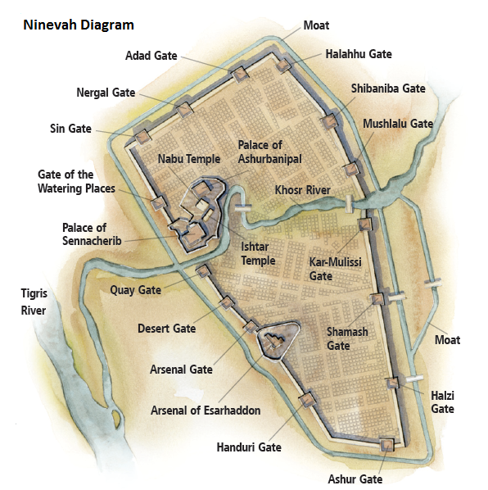
http://www.bing.com/images/search?q=khosr+river&view=detailv2&&qpvt=khosr+river&id=9D6CF526BAD1B360B91EFB3B5D7BDDBFBE3C9245&selectedIndex=31&ccid=lNfXUqpC&simid=608045027490070564&thid=JN.uFsvnj1pvhzHfO3%2bMmgj6Q&ajaxhist=0

Slide 10
Nah. 2: 7 And Huzzab shall be led away captive, she shall be brought up, and her maids shall lead her as with the voice of doves, tabering upon their breasts.
Nah. 2: 8 But Nineveh is of old like a pool of water: yet they shall flee away. Stand, stand, shall they cry; but none shall look back.

Slide 11
Conclusion
1 Pet. 4:17 For the time is come that judgment must begin at the house of God: and if it first begin at us, what shall the end be of them that obey not the gospel of God?
18 And if the righteous scarcely be saved, where shall the ungodly and the sinner appear?
Jn. 3:36 He that believeth on the Son hath everlasting life: and he that believeth not the Son shall not see life; but the wrath of God abideth on him.
2 Cor. 5:9 Wherefore we labour, that, whether present or absent, we may be accepted of him.
10 For we must all appear before the judgment seat of Christ; that every one may receive the things done in his body, according to that he hath done, whether it be good or bad.
11 Knowing therefore the terror of the Lord, we persuade men; but we are made manifest unto God; and I trust also are made manifest in your consciences.

Slide 12
B. The Sack of Nineveh, 2:9-13
Nah. 2:9 Take ye the spoil of silver, take the spoil of gold: for there is none end of the store and glory out of all the pleasant furniture.
10 She is empty, and void, and waste: and the heart melteth, and the knees smite together, and much pain is in all loins, and the faces of them all gather blackness.
11 Where is the dwelling of the lions, and the feedingplace of the young lions, where the lion, even the old lion, walked, and the lion’s whelp, and none made them afraid?
12 The lion did tear in pieces enough for his whelps, and strangled for his lionesses, and filled his holes with prey, and his dens with ravin.
13 Behold, I am against thee, saith the LORD of hosts, and I will burn her chariots in the smoke, and the sword shall devour thy young lions: and I will cut off thy prey from the earth, and the voice of thy messengers shall no more be heard.

Slide 13
Nah. 2:13 Behold, I am against thee, saith the LORD of hosts, and I will burn her chariots in the smoke, and the sword shall devour thy young lions: and I will cut off thy prey from the earth, and the voice of thy messengers shall no more be heard.
Ezek. 38:3 And say, Thus saith the Lord GOD; Behold, I am against thee, O Gog, the chief prince of Meshech and Tubal:
Ezek. 39:1 Therefore, thou son of man, prophesy against Gog, and say, Thus saith the Lord GOD; Behold, I am against thee, O Gog, the chief prince of Meshech and Tubal:
Nah. 3:5 Behold, I am against thee, saith the LORD of hosts; and I will discover thy skirts upon thy face, and I will shew the nations thy nakedness, and the kingdoms thy shame.

Slide 14
Conclusion
1 Pet. 4:17 For the time is come that judgment must begin at the house of God: and if it first begin at us, what shall the end be of them that obey not the gospel of God?
18 And if the righteous scarcely be saved, where shall the ungodly and the sinner appear?
Jn. 3:36 He that believeth on the Son hath everlasting life: and he that believeth not the Son shall not see life; but the wrath of God abideth on him.
2 Cor. 5:9 Wherefore we labour, that, whether present or absent, we may be accepted of him.
10 For we must all appear before the judgment seat of Christ; that every one may receive the things done in his body, according to that he hath done, whether it be good or bad.
11 Knowing therefore the terror of the Lord, we persuade men; but we are made manifest unto God; and I trust also are made manifest in your consciences.

