Slide 1
THE KINGDOM AND YOUR MISSION

Slide 2
KING JESUS ANNOUNCED AND USHERED IN HIS KINGDOM

Slide 3
KING JESUS ANNOUNCED AND USHERED IN HIS KINGDOM
His Kingdom is spiritual.
His Kingdom is eternal.
His Kingdom is global.

Slide 4
We must THINK GLOBALLY and ACT LOCALLY.

Slide 5
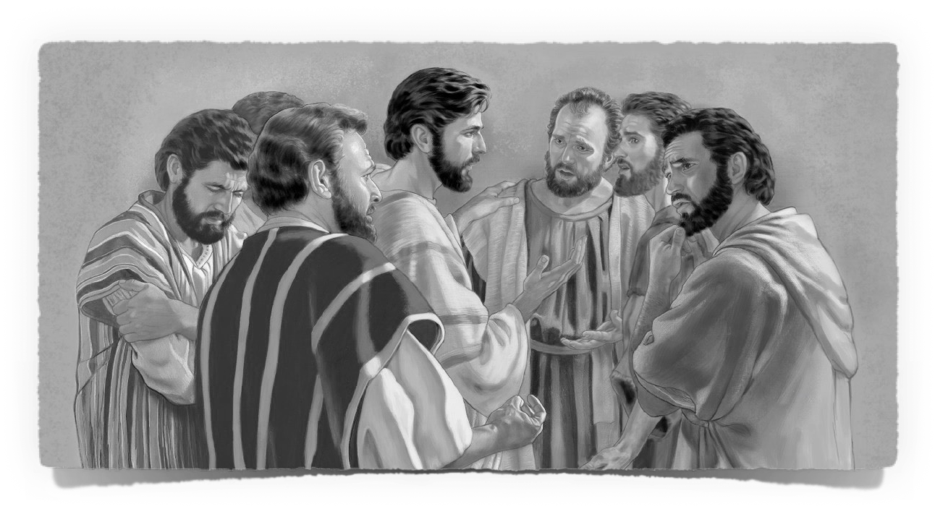
THE ANNOUNCEMENT OF THE KINGDOM MISSION

Slide 6
1. In those days came John the Baptist, preaching in the wilderness of Judaea, 2. And saying, Repent ye: for the kingdom of heaven is at hand.
Matthew 3:1-2

Slide 7
From that time Jesus began to preach, and to say, Repent: for the kingdom of heaven is at hand.
Matthew 4:17

Slide 8
Jesus answered and said unto him, Verily, verily, I say unto thee, Except a man be born again, he cannot see the kingdom of God.
John 3:3

Slide 9
Jesus answered, Verily, verily, I say unto thee, Except a man be born of water and of the Spirit, he cannot enter into the kingdom of God.
John 3:5

Slide 10
18. And Jesus, walking by the sea of Galilee, saw two brethren, Simon called Peter, and Andrew his brother, casting a net into the sea: for they were fishers. 19. And he saith unto them, Follow me, and I will make you fishers of men. 20. And they straightway left their nets, and followed him. 21. And going on from thence, he saw other two brethren, James the son of Zebedee, and John his brother, in a ship with Zebedee their father, mending their nets; and he called them. 22. And they immediately left the ship and their father, and followed him.
Matthew 4:18-22

Slide 11
"Our role in the kingdom is like clearing a path for people to come to Jesus and either WORSHIP HIM or REJECT HIM."
--Donnie Griggs, Small Town Jesus

Slide 12
THE EXPANSION of THE KINGDOM MISSION

Slide 13
1. The same day went Jesus out of the house, and sat by the sea side. 2. And great multitudes were gathered together unto him, so that he went into a ship, and sat; and the whole multitude stood on the shore. 3. And he spake many things unto them in parables, saying, Behold, a sower went forth to sow;
Matthew 13:1-3

Slide 14
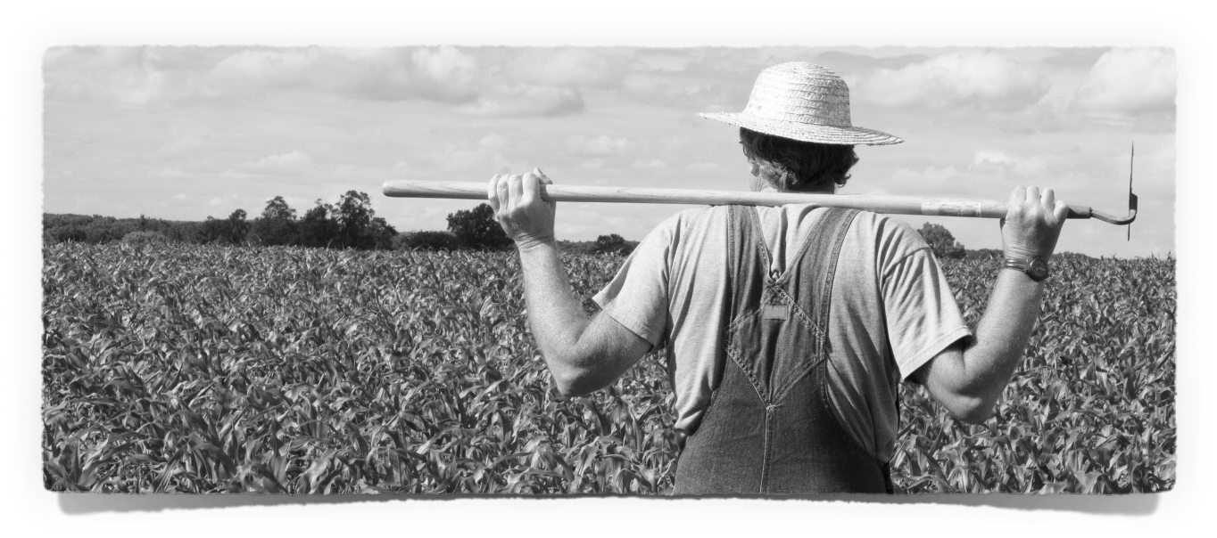
But he that received seed into the good ground is he that heareth the word, and understandeth it; which also beareth fruit, and bringeth forth, some an hundredfold, some sixty, some thirty.
Matthew 13:23

Slide 15
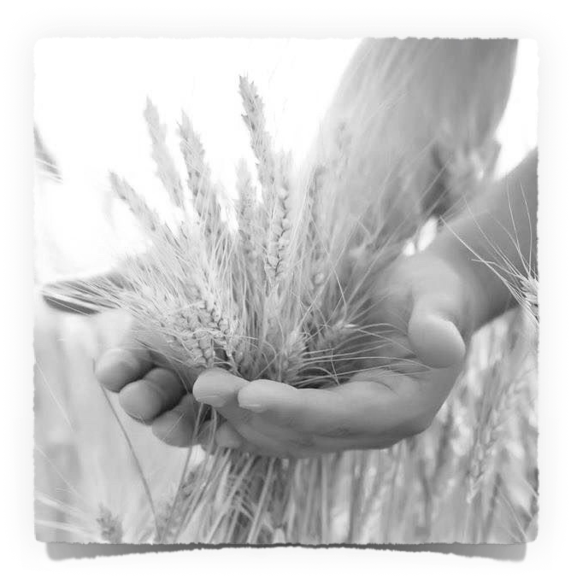
". . . gather the
wheat into my barn"
Matthew 13:30

Slide 16
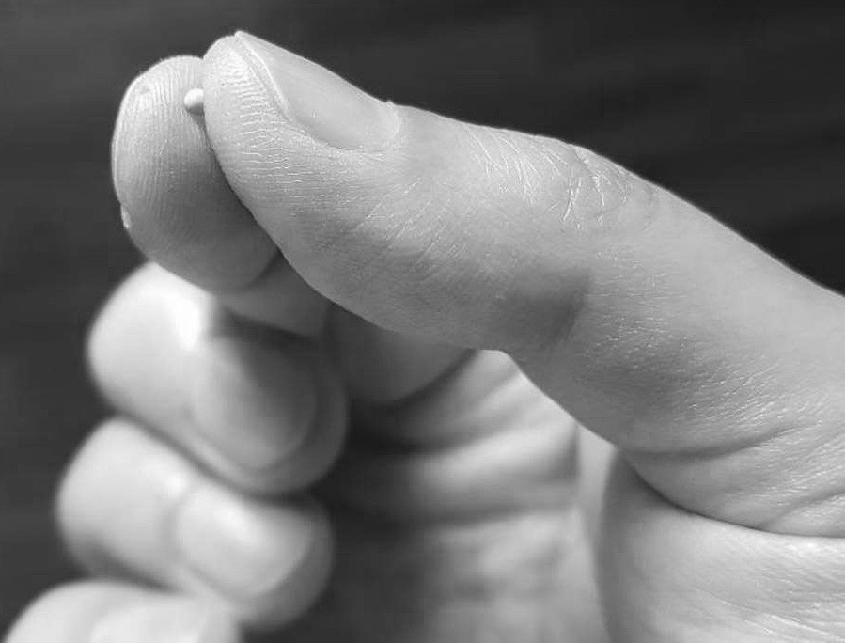
31. Another parable put he forth unto them, saying, The kingdom of heaven is like to a grain of mustard seed, which a man took, and sowed in his field: 32. Which indeed is the least of all seeds: but when it is grown, it is the greatest among herbs, and becometh a tree, so that the birds of the air come and lodge in the branches thereof.
Matthew 13:31,32

Slide 17
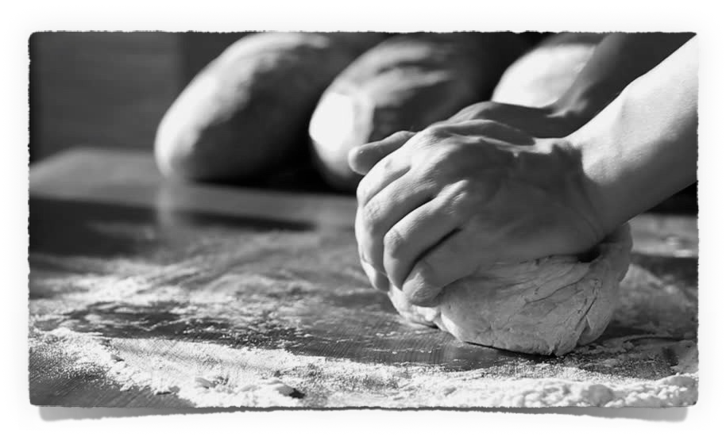
Another parable spake he unto them; The kingdom of heaven is like unto leaven, which a woman took, and hid in three measures of meal, till the whole was leavened.
Matthew 13:33

Slide 18
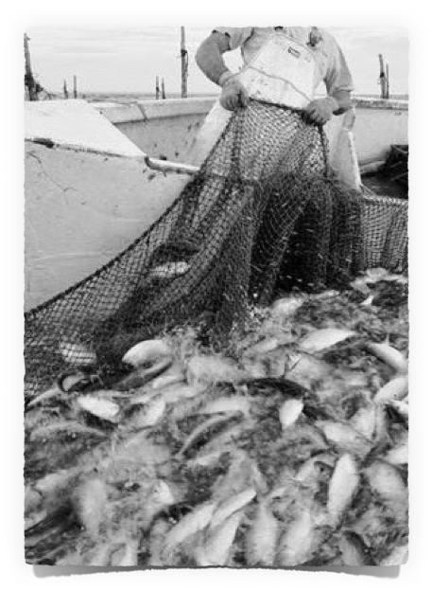
47. Again, the kingdom of heaven is like unto a net, that was cast into the sea, and gathered of every kind: 48. Which, when it was full, they drew to shore, and sat down, and gathered the good into vessels, but cast the bad away.
Matthew 13:47,48

Slide 19
The Kingdom
...growing...expanding...productivity!

Slide 20
44. Again, the kingdom of heaven is like unto treasure hid in a field; the which when a man hath found, he hideth, and for joy thereof goeth and selleth all that he hath, and buyeth that field.
45. Again, the kingdom of heaven is like unto a merchant man, seeking goodly pearls: 46. Who, when he had found one pearl of great price, went and sold all that he had, and bought it.
Matthew 13:44-46

Slide 21
THE EMBRACING OF OUR KINGDOM MISSION

Slide 22
Jesus saith unto them, Have ye understood all these things? They say unto him, Yea, Lord.
Matthew 13:51

Slide 23
Then said he unto them, Therefore every scribe which is instructed unto the kingdom of heaven is like unto a man that is an householder, which bringeth forth out of his treasure things new and old.
Matthew 13:52

Slide 24
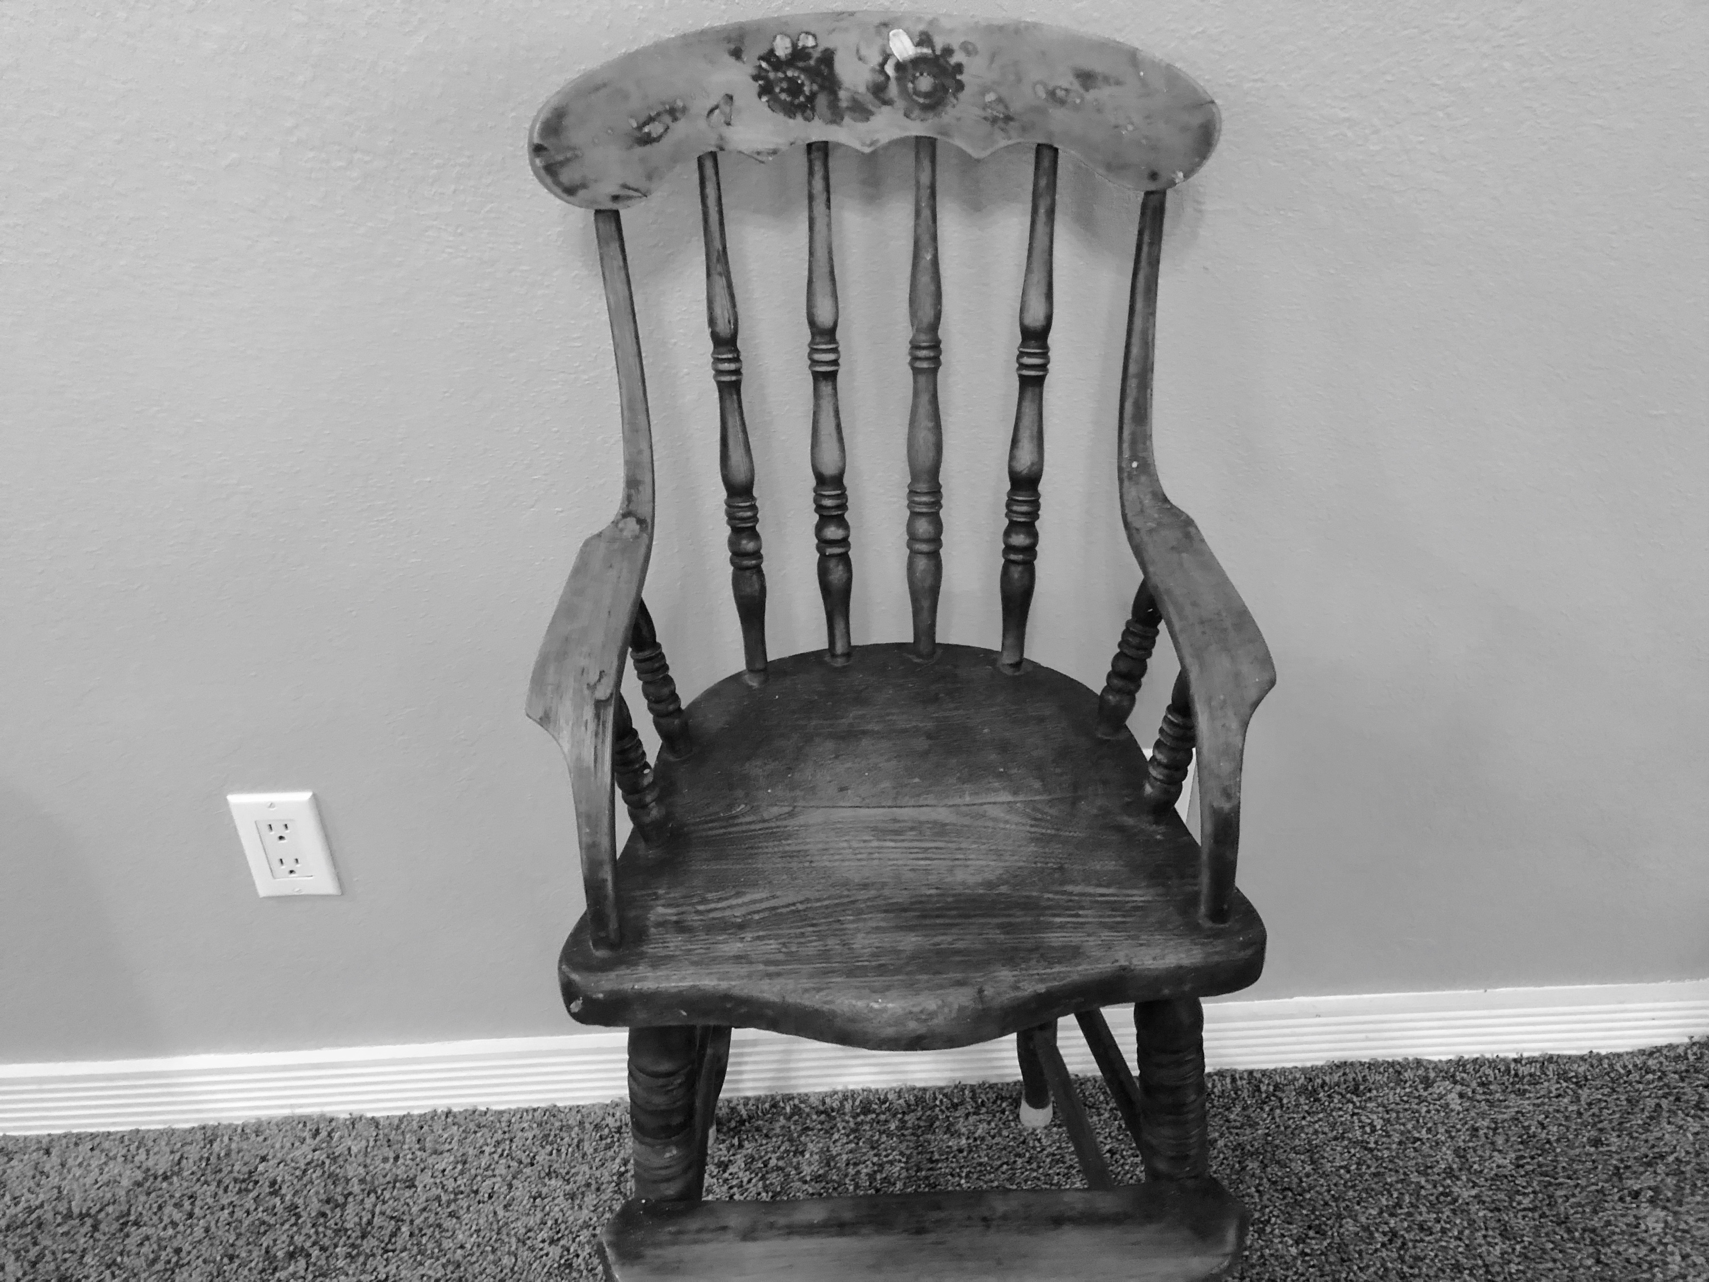

Slide 25
THE KINGDOM AND
YOUR MISSION

